Slide 1
Linear Regression Part I: Introduction
Dr. Upender Subramanian
MKT/BUAN 6337

Slide 2
What is Regression?
Class of statistical techniques to “estimate” the relationship between an outcome / dependent variable (Y) and several predictors / explanatory / independent variables (X_{i})
Various techniques depending on the type of outcome variable, type of relationship, assumptions about data, performance criteria
Basic tool for market response modeling
How does sales respond to price and advertising?
How do customer characteristics affect the likelihood of the customer responding to the offer?
How do different online ads affect click through rate?
How do product and service features affect customer satisfaction?

Slide 3
Regression Model
Relationship between outcome and explanatory variables is usually specified as a “parametric” “model”
Model: a mathematical function that relates the outcome to the explanatory variables
E.g., Y = f(X₁, X₂) = a + b*X₁ + c*X₂
Parameters: variables whose values determine the specific form of the function
E.g. a, b and c are the parameters in the above example

Slide 4
Estimation
Mathematical procedure to determine the values of model parameters that “best” describe the relationship in a given dataset
The same model of a relationship could be estimated in different ways depending on assumptions about the data and performance criteria
E.g., a linear regression model could be estimated using ordinary least squares, maximum likelihood, ridge regression, robust regression, lasso regression etc.

Slide 5
Why is it Useful?
Captures effect of multiple variables on outcome simultaneously
Most phenomena are affected by more than one factor
Simple bivariate analysis (e.g. correlation) cannot capture the relation
E.g. Sales = 100 – 0.5 * Price + 2 * Advertising_Spend
+ 0.2 * Competitor_Price – 1* Competitor_Ad_Spend
Estimates relationship even if multiple variables change at a time
Does not require data where only one variable changes at a time;
Isolates unique effect of one variable, accounting for the effect of all other variables
Allows detection of spurious relationship between two variables by explicitly controlling for the effect of all other variables

Slide 6
Powerful or Powerfool!
Regression is a powerful tool for forecasting. Economists using it successfully predicted ten out of the last two recessions.
- Christopher Doyle‏
Regression is very versatile, BUT analyst needs to be cautious and conduct due diligence before relying on it

Slide 7
Job of the Regression Analyst
Select a suitable regression method
Based on nature of outcome variable, method assumptions and its strengths/weaknesses for specific application
Specify model(s) to be estimated
Based on prior knowledge about nature of relationship, research / business question to be answered, parsimony (simpler model is better), or plain brute force
Estimate the model(s)
Verify whether model assumptions are satisfied
Evaluate model results and performance
Are estimates sensible? Is model fit / performance good?
Choose the “best” model and use it for predictions

Slide 8
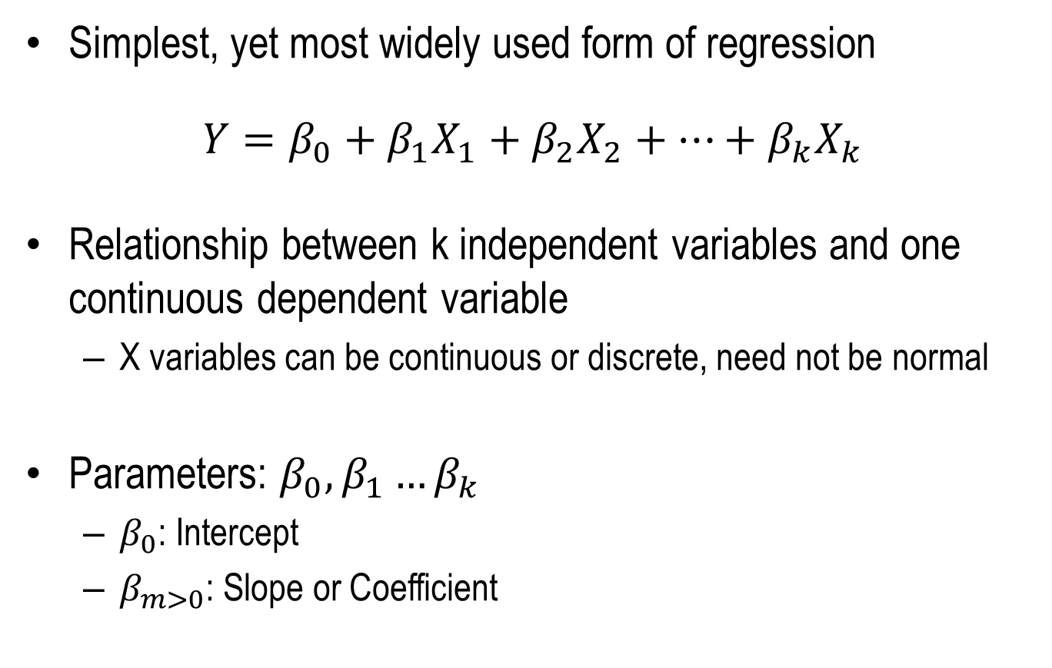
Linear Regression
Simplest, yet most widely used form of regression
$$Y=β_{0}+β_{1}X_{1}+β_{2}X_{2}+…+β_{k}X_{k}$$
Relationship between k independent variables and one continuous dependent variable
X variables can be continuous or discrete, need not be normal
Parameters: $β_{0},β_{1}…β_{k}$
$β_{0}$: Intercept
$β_{m>0}$: Slope or Coefficient

Slide 9
What is “Linear” About Linear Regression?
Model is linear in parameters (not necessarily in the dependent or independent variables)
Parameters do not have exponents or multiply other parameters
Parameters do not occur as exponents of variables or parameters
Parameters do not divide other parameters or variables

Slide 10
Which of these are “Linear”?
Sales = A + B*Price + C*Price^2
Log(Sales) = A + B*Price
Log(Sales) = A + B*Log(Price)
Sales = A + B*Log(Price/Income)
Sales = A + B*Price + C*Advertising + D*Price*Advertising
Sales = (A + B*Price) / (C + D*Income)

Slide 11
A Common Mistake to Avoid
For model to sensible avoid the following:
Dependent variable is created (directly or indirectly) using some of the independent variables
Independent variable is created (directly or indirectly) using a dependent variable
Otherwise, the estimated relationship will not be meaningful and will be incorrect

Slide 12
Examples: Which Models Are Sensible?
Sales = A + B*Price + C*Advertising
Revenues = A + B*Price + C*Quantity_Sold
Click_Through_Rate = A+B*Number_of_Clicks
Number_of_Clicks = A+B*Number_of_Impressions
Click_Through_Rate = A+B*Number_of_Impressions

Slide 13
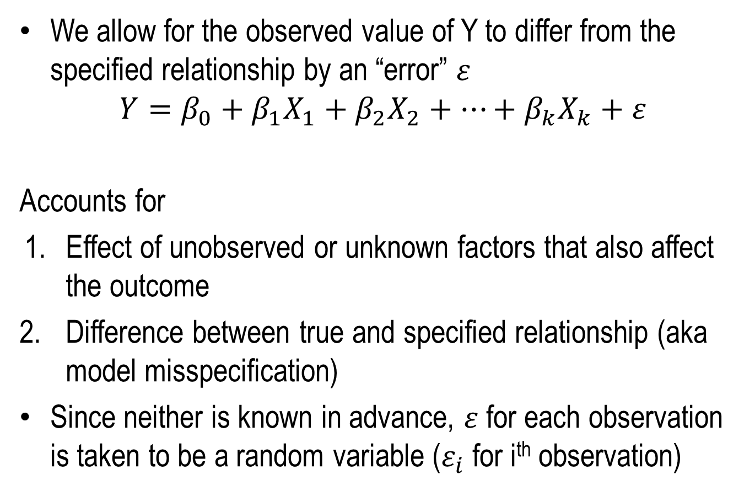
The Error Term
We allow for the observed value of Y to differ from the specified relationship by an “error” $ε$
$$Y=β_{0}+β_{1}X_{1}+β_{2}X_{2}+…+β_{k}X_{k}+ε$$
Accounts for
Effect of unobserved or unknown factors that also affect the outcome
Difference between true and specified relationship (aka model misspecification)
Since neither is known in advance, $ε$for each observation is taken to be a random variable ($ε_{i}$ for i^{th} observation)

Slide 14
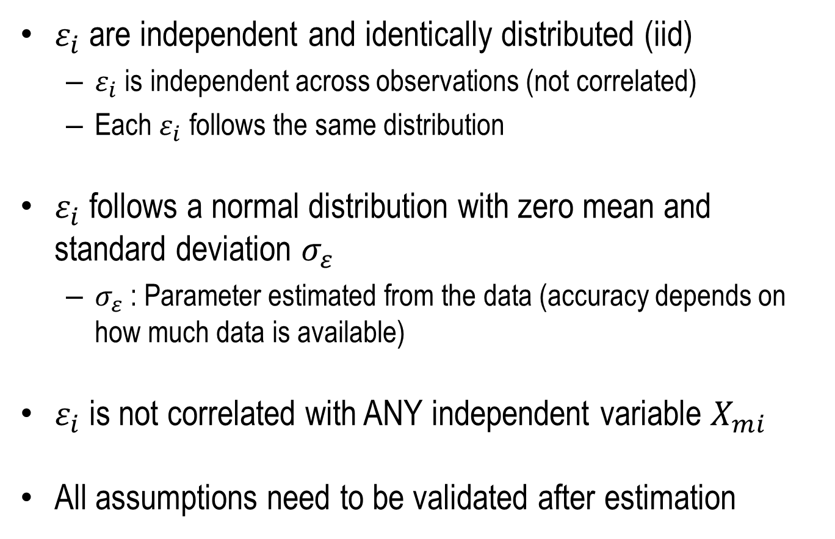
Assumptions for Standard Linear Regression
$ε_{i}$ are independent and identically distributed (iid)
$ε_{i}$ is independent across observations (not correlated)
Each $ε_{i}$ follows the same distribution
$ε_{i}$ follows a normal distribution with zero mean and standard deviation $σ_{ε}$
$σ_{ε}$ : Parameter estimated from the data (accuracy depends on how much data is available)
$ε_{i}$ is not correlated with ANY independent variable $X_{mi}$
All assumptions need to be validated after estimation

Slide 15
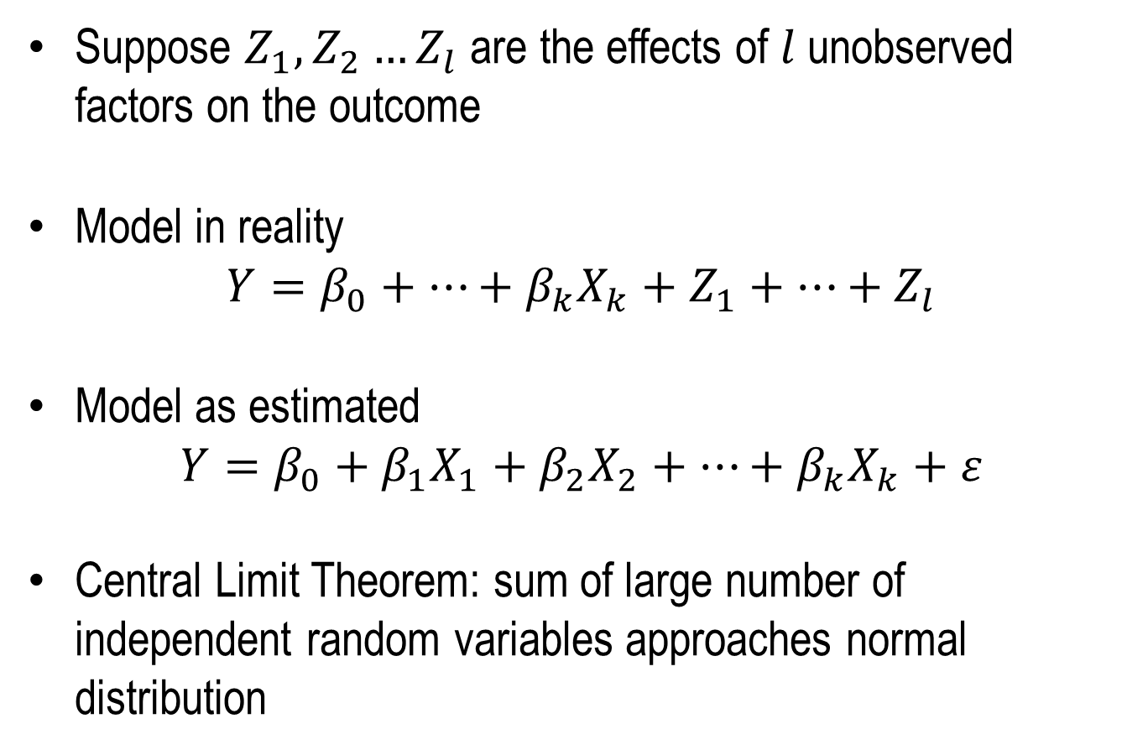
Why Normal Distribution?
Suppose $Z_{1},Z_{2}…Z_{l}$ are the effects of $l$ unobserved factors on the outcome
Model in reality
$$Y=β_{0}+…+β_{k}X_{k}+Z_{1}+…+Z_{l}$$
Model as estimated
$$Y=β_{0}+β_{1}X_{1}+β_{2}X_{2}+…+β_{k}X_{k}+ε$$
Central Limit Theorem: sum of large number of independent random variables approaches normal distribution

Slide 16
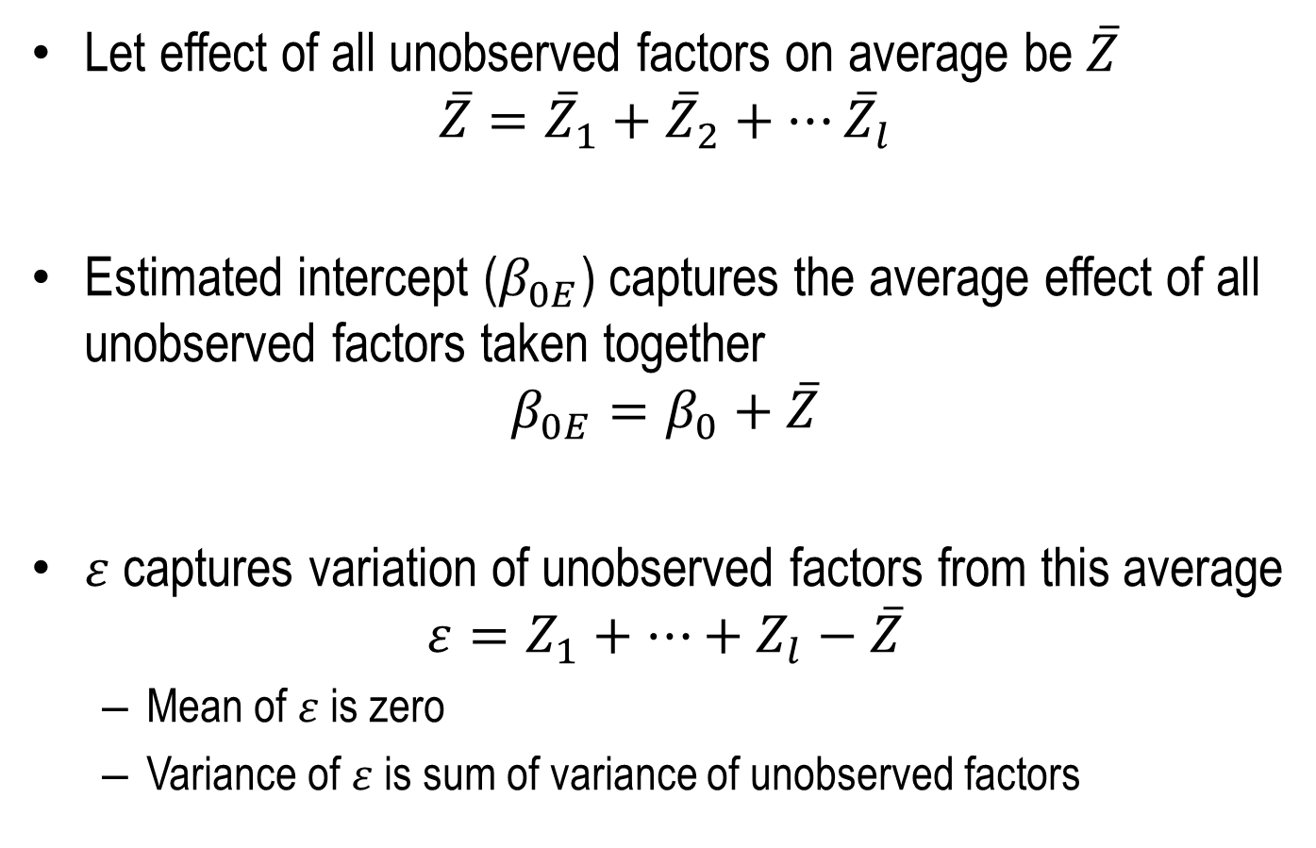
Why Normal Distribution?
Let effect of all unobserved factors on average be $\overline{Z}$
$$\overline{Z}={\overline{Z}}_{1}+{\overline{Z}}_{2}+…{\overline{Z}}_{l}$$
Estimated intercept ($β_{0E}$) captures the average effect of all unobserved factors taken together
$$β_{0E}=β_{0}+\overline{Z}$$
$ε$ captures variation of unobserved factors from this average
$$ε=Z_{1}+…+Z_{l}−\overline{Z}$$
Mean of $ε$is zero
Variance of $ε$is sum of variance of unobserved factors

Slide 17
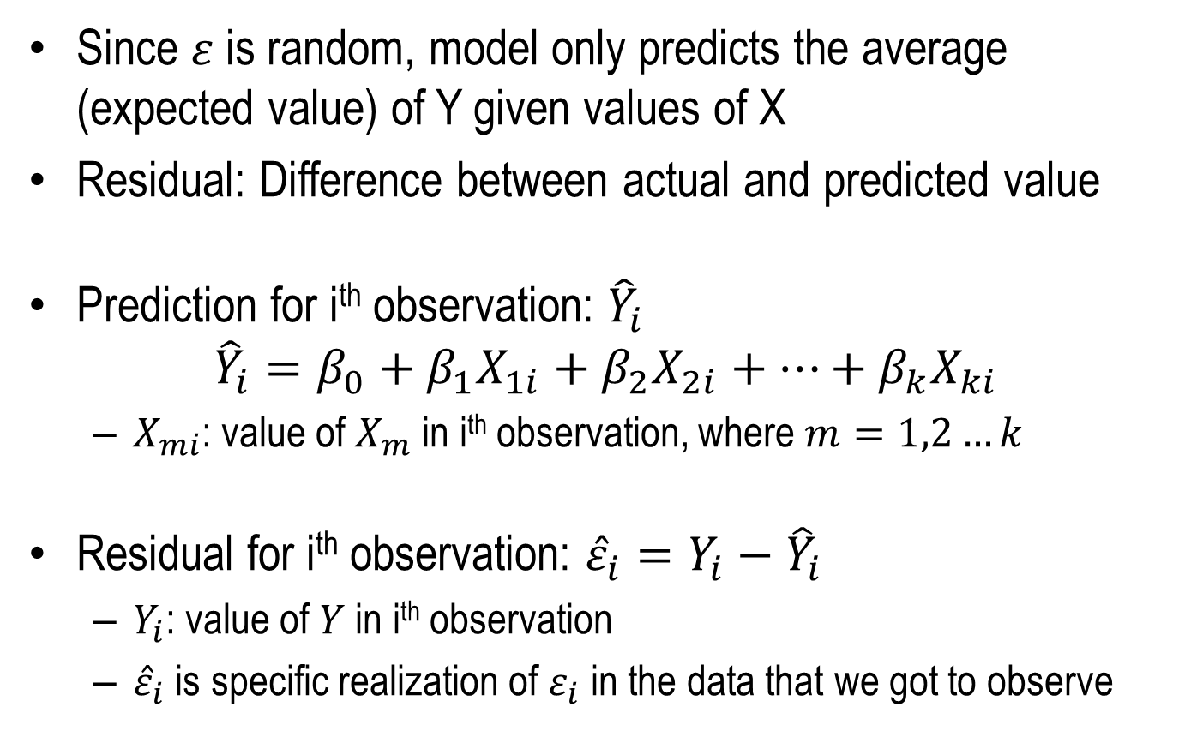
Model Prediction and Residuals
Since $ε$ is random, model only predicts the average (expected value) of Y given values of X
Residual: Difference between actual and predicted value
Prediction for i^{th} observation: ${\hat{Y}}_{i}$
$${\hat{Y}}_{i}=β_{0}+β_{1}X_{1i}+β_{2}X_{2i}+…+β_{k}X_{ki}$$
$X_{mi}$: value of $X_{m}$ in i^{th} observation, where $m=1,2…k$
Residual for i^{th} observation: ${\hat{ε}}_{i}=Y_{i}−{\hat{Y}}_{i}$
$Y_{i}$: value of $Y$ in i^{th} observation
${\hat{ε}}_{i}$ is specific realization of $ε_{i}$ in the data that we got to observe

